Slide 1
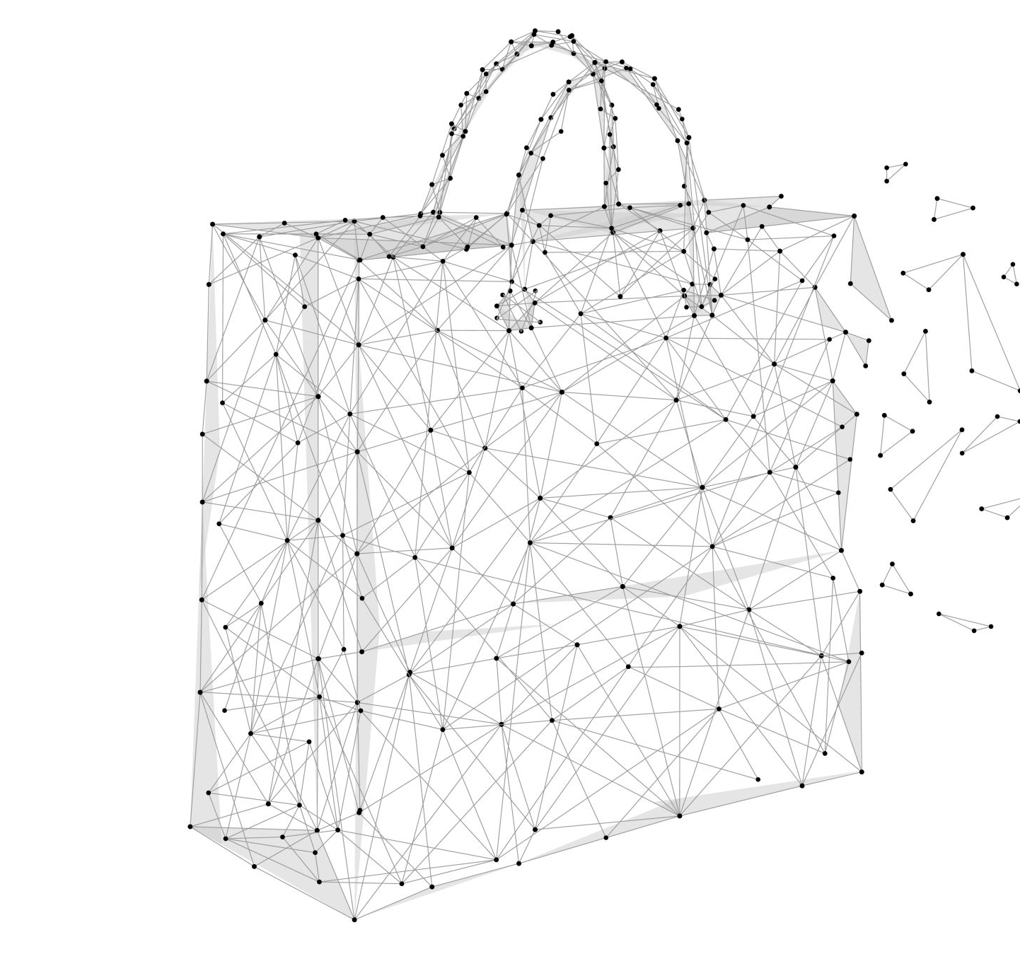
AI In Smart Shopping
.

Slide 2
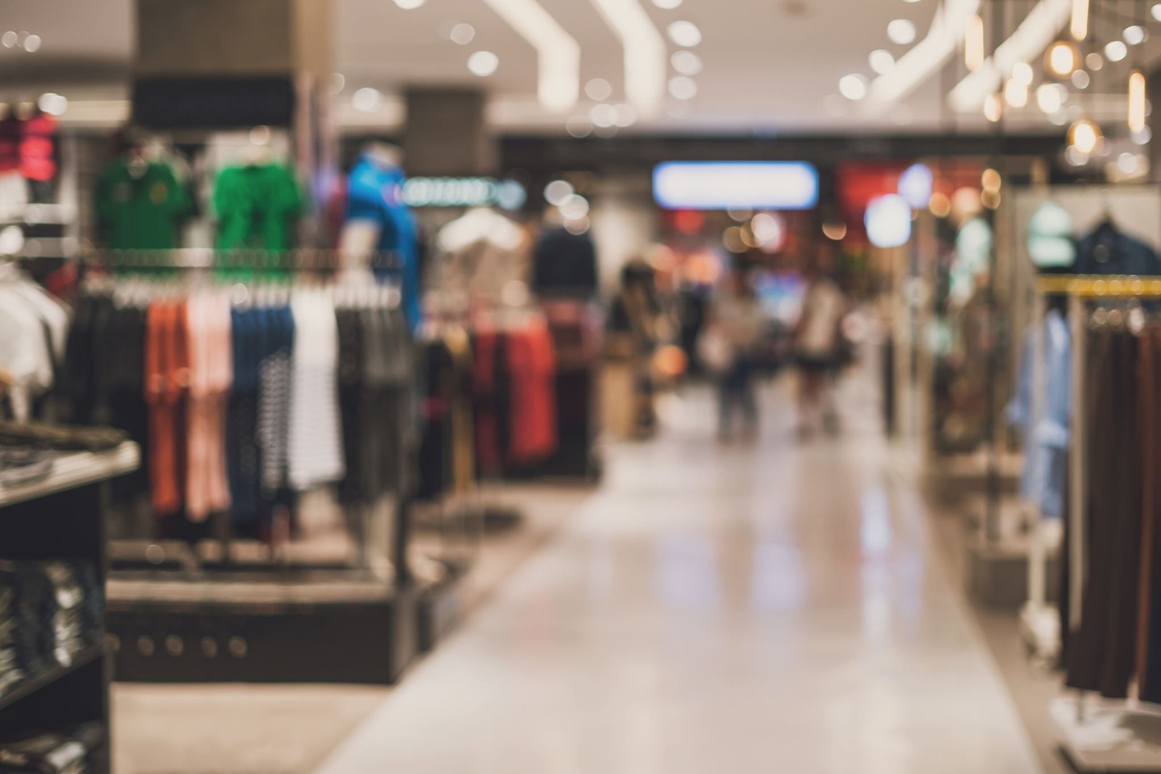
What is Smart Shopping and how AI can be used in it?
Smart shopping is a term used to describe the process of using technology and data to make informed purchasing decisions. It involves using tools like price comparison websites, customer reviews, and product recommendations to identify the best products for your needs and budget

Slide 3

AI Techniques Used in Smart Shopping

Slide 4
Machine Learning:
Machine learning is a subset of AI that enables computer systems to learn and improve from experience without being explicitly programmed. Machine learning algorithms can analyze vast amounts of data, identify patterns and trends, and make predictions or decisions based on that data. In smart shopping, machine learning is used to analyze customer data and purchase history to provide personalized recommendations etc.
Natural Language Processing:
Natural Language Processing (NLP) is an AI technique that enables machines to understand and process human language. In smart shopping, NLP is used to improve customer service by enabling chatbots or virtual assistants to communicate with customers in a natural language format. NLP can also be used for sentiment analysis to understand customer feedback and improve product recommendations

Slide 5
Computer Vision:
Computer Vision is an AI technique that enables machines to analyze and interpret visual data from the real world. Computer vision algorithms can identify and recognize objects, people, and other visual elements in images and videos. In smart shopping, computer vision is used for product recognition, such as identifying a specific product from an image or video. Computer vision can also be used for inventory management by enabling automated stock tracking and shelf monitoring.
Recommender Systems:
Recommender systems are AI algorithms that provide personalized recommendations to users based on their interests, preferences, and behavior. In smart shopping, recommender systems are used to suggest products or services that are likely to be of interest to customers based on their past purchases or browsing history. Recommender systems can use collaborative filtering, content-based filtering, or a combination of both to generate recommendations.

Slide 6
Application of AI in smart shopping:

Slide 7

Personalized Recommendations
AI algorithms can analyze your shopping history, browsing behavior, and other data to provide personalized product recommendations. By using machine learning algorithms, AI can analyze large data sets and identify patterns in your shopping behavior.
Chatbots and Virtual Assistants –
AI-powered chatbots and virtual assistants can provide instant customer support and answer questions about products, pricing, and shipping options. These chatbots can be integrated with e-commerce platforms to provide 24/7 support to customers, which can help businesses reduce response times and improve customer satisfaction.

Slide 8
Price Optimization –
AI can analyze market data, consumer behavior, and other factors to determine the optimal pricing strategy for products. By using machine learning algorithms, AI can analyze data in real-time and adjust pricing strategies accordingly, which can help businesses increase sales and profits.
Fraud Detection –
AI can help businesses detect fraudulent activities, such as credit card fraud and account takeover, by analyzing patterns in transaction data. By using machine learning algorithms, AI can identify patterns that are indicative of fraud and alert businesses to take action before the fraud occurs.

Slide 9
Inventory Management –
AI can help businesses optimize their inventory management by analyzing sales data, forecasting demand, and identifying trends in consumer behavior. By using machine learning algorithms, AI can predict when products are likely to sell out and alert businesses to restock before they run out of stock.

Slide 10

Implementation

Slide 11
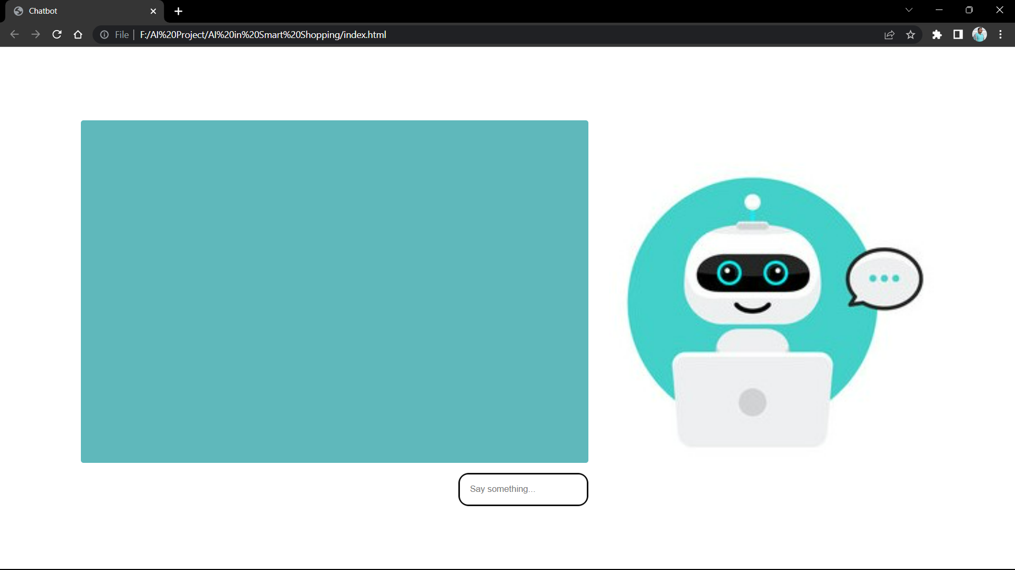
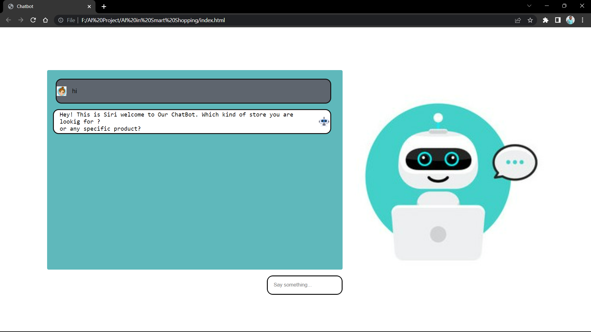

Slide 12
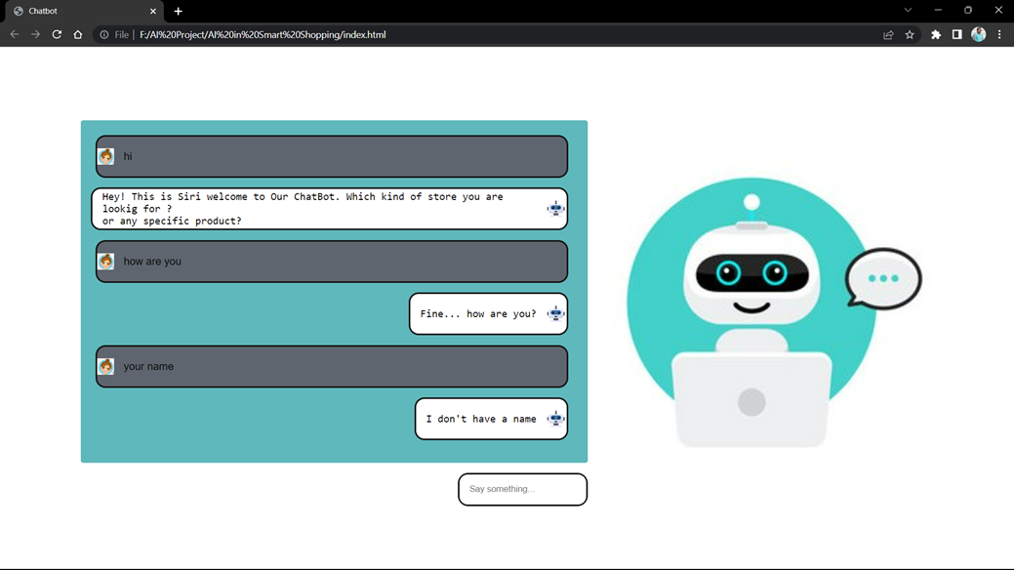
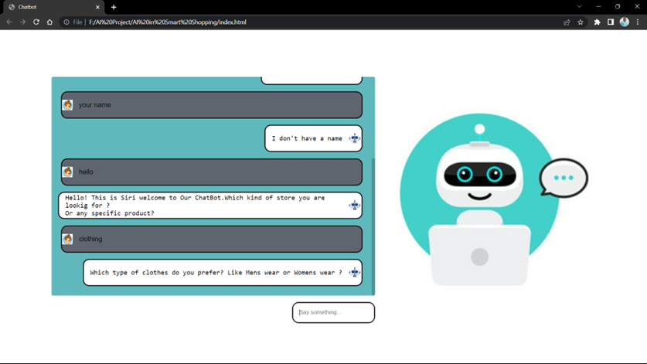

Slide 13
How chatbots can help customers in smart shopping
Product recommendations:
Chatbots can assist customers in finding the products they are looking for by providing personalized product recommendations based on their preferences and previous purchases. This can help customers save time and improve their overall shopping experience.
Order tracking:
Chatbots can assist customers in tracking their orders and providing updates on their delivery status. This can help customers stay informed and reduce the need for them to contact customer service.

Slide 14
Personalized assistance:
Chatbots can provide personalized assistance to customers by answering their questions and providing recommendations based on their preferences. This can help customers feel more engaged and satisfied with their shopping experience.
Convenience:
Chatbots can provide customers with a convenient and accessible way to shop, as they can easily access the chatbot from their mobile device or computer. This can help customers shop on their own terms and improve their overall satisfaction.

Slide 15
How chatbots can help businesses in smart shopping ?
Customer service: This can help businesses save time and money, while also improving the customer experience.
Inventory management: Chatbots can help businesses keep track of their inventory levels and alert them when they are running low on certain products.
Sales: Chatbots can assist businesses in driving sales by providing personalized product recommendations to customers.
Cost savings: Chatbots can help businesses save money by automating repetitive tasks, such as customer service inquiries and inventory management.
Competitive advantage: Chatbots can help businesses stay ahead of the competition by providing a more personalized and efficient shopping experience for customers

Slide 16
Ethical Considerations of AI in Smart Shopping

Slide 17
Privacy:
One of the primary ethical concerns of AI in smart shopping is privacy. AI systems collect and analyze vast amounts of customer data, including personal information such as purchase history, location data, and even biometric data. Customers may be concerned about how their data is being collected, stored, and used, particularly if it is being shared with third-party companies or used for advertising purposes. Smart shopping systems must be transparent about how customer data is being collected and used and provide customers with the ability to control their data.
Bias:
Another ethical consideration of AI in smart shopping is bias. AI systems can inadvertently perpetuate existing biases, particularly if they are trained on biased data sets. For example, a recommender system may recommend certain products or services to customers based on their race, gender, or other personal characteristics. Smart shopping systems must be designed and trained to avoid biases and ensure that they treat all customers fairly.

Slide 18
Customer Manipulation:
Another ethical concern of AI in smart shopping is customer manipulation. AI systems can be used to manipulate customer behavior and preferences, such as by providing personalized discounts or using persuasive language to encourage customers to make a purchase. While these tactics may be effective in increasing sales, they may also be seen as manipulative or even unethical. Smart shopping systems must balance the need to increase sales with the need to respect customer autonomy and avoid manipulative tactics.
Job Loss:
Finally, AI in smart shopping has the potential to lead to job loss, particularly in retail and customer service industries. AI systems can automate many tasks that were previously performed by human employees, such as inventory management, customer service, and even checkout. While this can increase efficiency and reduce costs for retailers, it can also lead to job loss and economic disruption for workers. Smart shopping systems must consider the impact on workers and work to mitigate the negative effects of automation.

Slide 19
Future of AI in Smart Shopping

Slide 20
Advancements in AI Technology:
Advancements in AI technology are expected to drive the future of smart shopping. As AI technology continues to improve, smart shopping systems will become more accurate, efficient, and effective at predicting customer behavior and providing personalized recommendations. This could include advancements in machine learning, natural language processing, and computer vision, as well as the development of new AI techniques and algorithms.
Integration of AI in Physical Retail Stores:
The integration of AI in physical retail stores is also expected to be a major trend in the future of smart shopping. Retailers can use AI systems to analyze customer behavior in physical stores, such as tracking foot traffic and monitoring customer interactions with products. This data can be used to optimize store layouts, improve product placement, and enhance the overall shopping experience.

Slide 21
Increased Personalization:
Another trend in the future of smart shopping is increased personalization. As AI systems become more sophisticated, they will be better able to analyze customer data and provide personalized recommendations and deals in real-time. This could include personalized pricing, customized promotions, and even personalized product design.
Augmented Reality Shopping:
Finally, augmented reality shopping is expected to be a significant trend in the future of smart shopping. Augmented reality (AR) technology enables customers to visualize products in 3D and in real-world settings, helping them to make more informed purchase decisions. AR shopping experiences could include virtual try-ons, product visualizations, and even virtual showrooms.

Slide 22
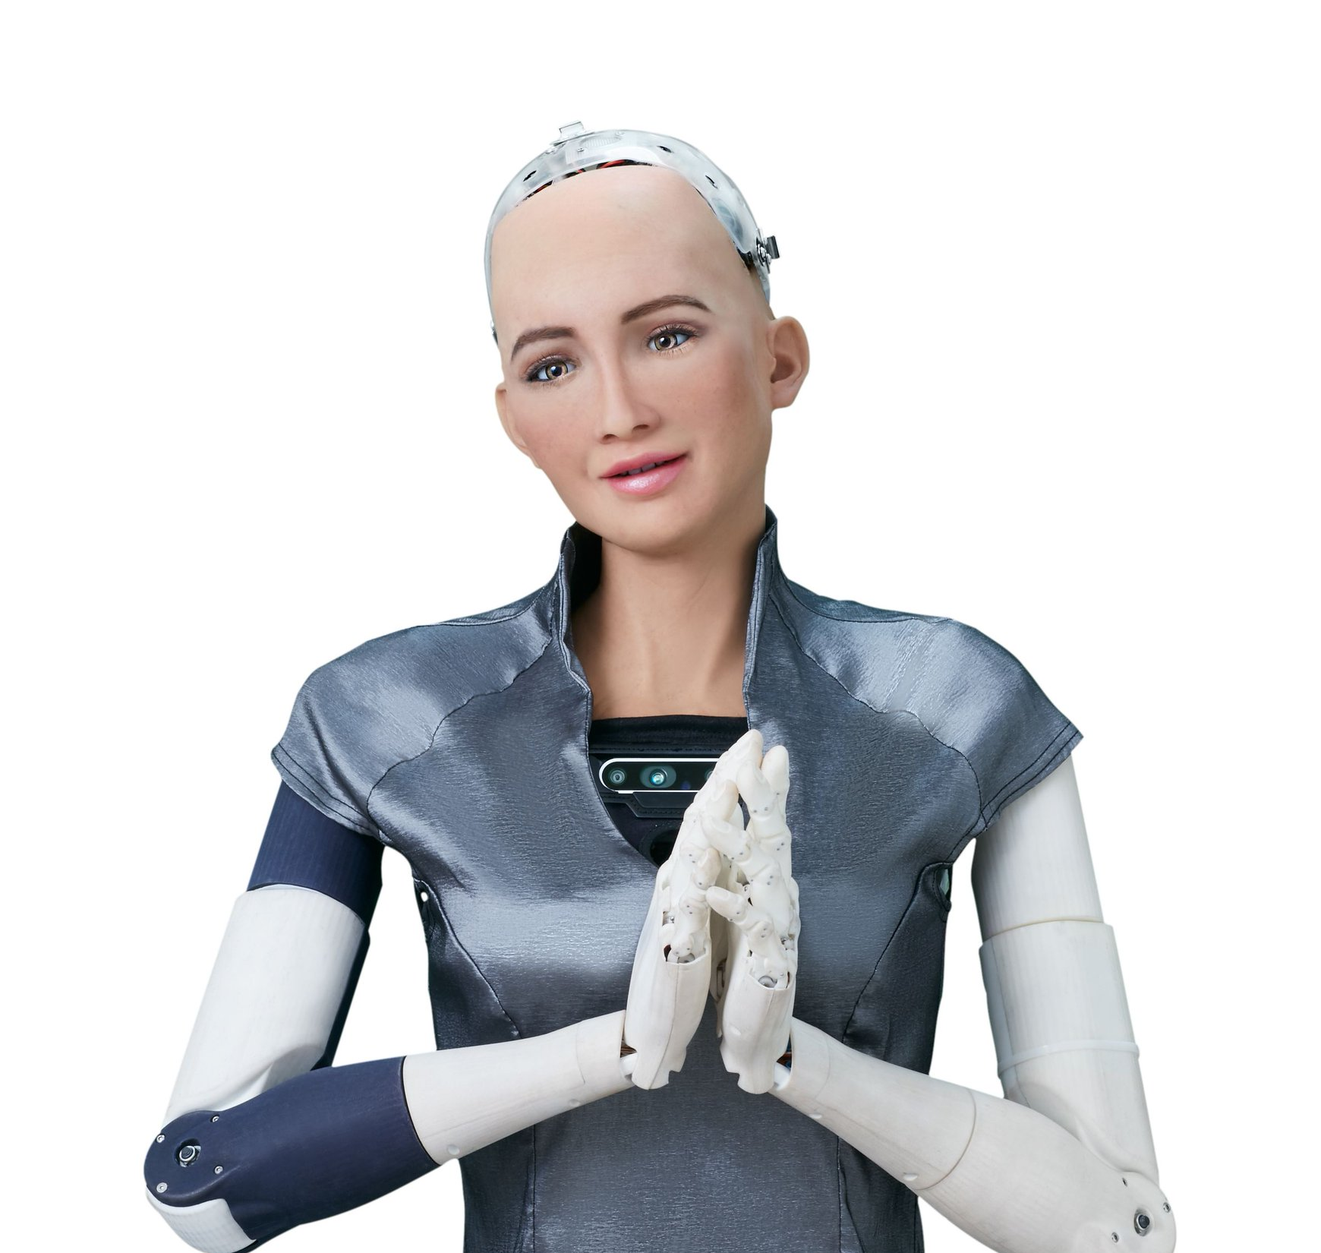
Thank You

